Slide 1
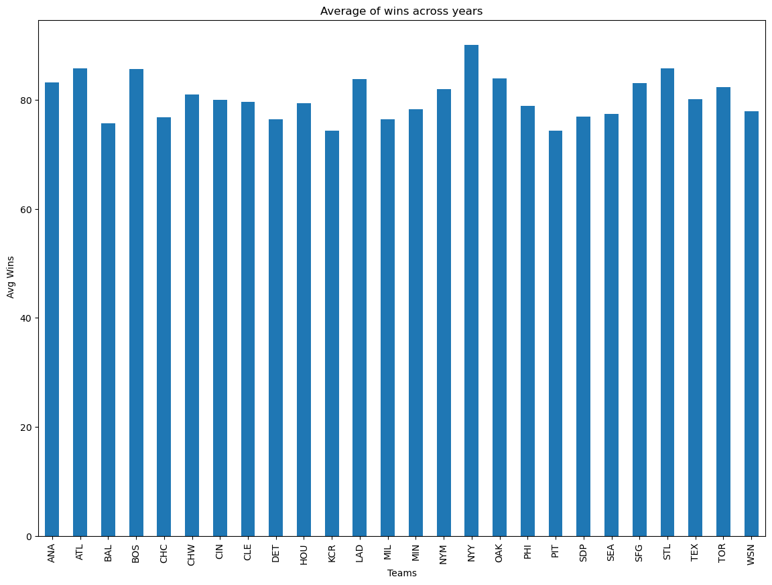

Most dominant team during the 30-year period and its correlation to salary
26 Teams
162 games
(1985-2015)

Slide 2
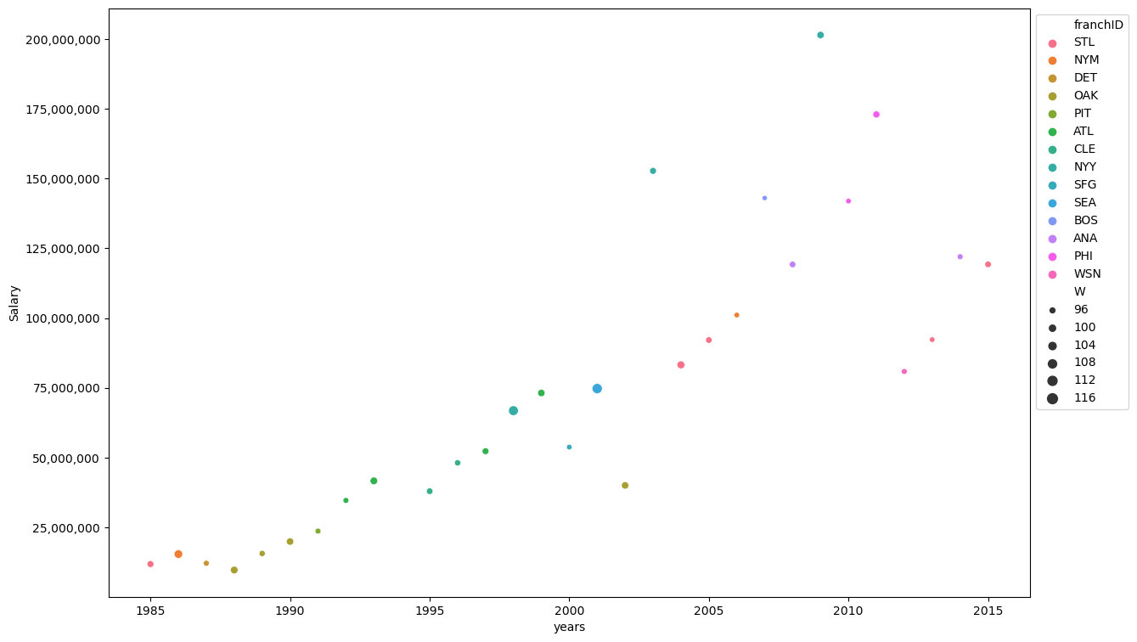
Most dominant teams in each year and its correlation to salary.
The correlation between salary and wins is -0.12754
NYY(103)
ANA(98)
NYY(114)
SEA(116)

